Slide 1
Employee Data Analysis using Excel
STUDENT NAME: parkavi.R
REGISTER NO:312216421
DEPARTMENT:BCOM CA
COLLEGE SHASUN JAIN COLLEGE FOR WOMEN

Slide 2
PROJECT TITLE
Employee Performance Analysis using Excel

Slide 3


AGENDA
Problem Statement
Project Overview
End Users
Our Solution and Proposition
Dataset Description
Modelling Approach
Results and Discussion
Conclusion
3/21/2024 Annual Review

Slide 4

PROBLEM STATEMENT : LOW PRODUCTIVITY HIGH ABSENTEEISM

Slide 5

PROJECT OVERVIEW EMPLOYEE DATA ANALYSIS:ANALYSIN THE PERFORMANCE OF THE EMPLOYEE BY CONSIDERING VARIOUS FACTOR LIKE GENDER, PERFORMANCE SCORE AND ACHIVEMENT
.

Slide 6

WHO ARE THE END USERS? MANAGER EMPLOYEES EMPLOYER IT SECTER

Slide 7

OUR SOLUTION AND ITS VALUE PROPOSITION CONDITIONAL FORMATTING,FILTERING,FORMULA,GRAPH

Slide 8
Dataset Description EMPLOYEE –KAGGLE 26 FEATURES 9 FEATURES NAME TEXT EMP TYPE PERFORMANCE LEVEL

Slide 9

THE "WOW" IN OUR SOLUTION PERFORMANCE LEVEL=IFS(Z8>=5,”VERY HIGH”,Z8>=3,”MED”<TRUE<LOW”)
3/21/2024 Annual Review
9

Slide 10
MODELING
DATA COLLETION
FEATURE COLLECTION
DATA CLEANING
PERFORMANCE LEVEL

Slide 11
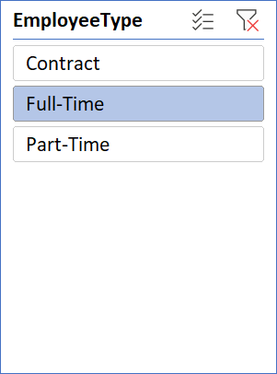
RESULTS
GenderCode | (All)
Count of FirstName | Column Labels
Row Labels | Exceeds | Fully Meets | Needs Improvement | PIP | Grand Total
BPC | 12 | 84 | 10 | 2 | 108
CCDR | 15 | 91 | 8 | 2 | 116
EW | 10 | 80 | 4 | 5 | 99
MSC | 13 | 86 | 5 | 2 | 106
NEL | 10 | 83 | 2 | 5 | 100
PL | 12 | 82 | 5 | 6 | 105
PYZ | 11 | 82 | 11 | 4 | 108
SVG | 11 | 79 | 4 | 2 | 96
TNS | 12 | 79 | 7 | 1 | 99
WBL | 14 | 77 | 9 | 1 | 101
Grand Total | 120 | 823 | 65 | 30 | 1038
11

Slide 12
Conclusion THEY ARE PERFORMED WELL COMPARING TO THE REMAING DEPARTMENT

